Slide 1
General Remarks
This is the second identical session on this topic (first session held on 25th March 0800-0900 CET)
The session will be recorded and the recording will be available on the INFCOM-3 website
Later part of the session will be dedicated to your questions, please
raise your hand
use the chat, or
send an email to : cgallage@wmo.int
INFCOM-3 Documents : INFCOM-3 Session information(wmo.int)
INFCOM-3-d08-5(1)-AG-OCEAN-ENGAGEMENT-PlAN-draft1_en
INFCOM-3-d08-1(1)-AMENDMENTS-WIGOS-MANUAL-ANNEX-draft1_en
INFCOM-3-d08-1(2)-WIGOS-GUIDE-AND-RWC-GUIDELINES-UPDATE-ANNEX-1-draft1_en

Slide 2
Advisory Group on the Ocean
(AG-Ocean)
INFCOM-3-d08-5(1)-AG-OCEAN-ENGAGEMENT-PLAN-draft1_en
Dr Boris Kelly-Gerreyn
Chair, AG-Ocean
Bureau of Meteorology
Australia
Katy Hill
Vice-Chair, AG-Ocean
National Oceanography
Centre, UK
Myrian Reneé Tamayo Infantes
Vice-Chair, AG-Ocean
Peruvian Navy
Peru
Pre INFCOM-3, Ocean Information Session (25th and 27th March 2024)

Slide 3
AG-Ocean
INFCOM-2 session approved the recommendations of the former Study Group on Ocean Observations and Infrastructure Systems (SG-OOIS) to establish AG-Ocean to:
Build connections between WMO and ocean infrastructure across observations, data and prediction systems
Enable WMO to draw on and contribute to ocean capability in advancing Earth System Approaches to meet its strategic objectives
Identify Gaps and develop strategies to address them.
Tearms of Reference

Slide 4
AG-Ocean Clarity on Mission
Our role is advisory
We advocate, advise and champion and we do NOT implement
We can't address everything stakeholders want us to do
We focus on key priority areas where we can make a difference
Where connections are strong, we acknowledge
Where connections are weak or missing, we pay attention
We will work closely with our stakeholders to
ensure our advice is based on the high(est) priorities
keep them informed, engaged and supportive

Slide 5
The Engagement Plan
Engagement Plan is the FIRST engagement plan which will be reviewed every ~1-2 years for impact and relevance
Purpose: Articulates priority focus areas based on issue, gap and opportunity analysis drawing on key strategic documents, knowledge and expertise within AG-Ocean, and stakeholder input.
Goal: to help establish long-term, operational working arrangements between the WMO and the ocean infrastructure community for the benefit of all nations.
Three themes : Observations, Data and Prediction.

Slide 6
Engagement Plan
3 themes – Observations, Data sharing, Prediction
12 focus areas – aligned to WMO strategy and JCB strategy
23 Recommended actions (others lead but AG-Ocean initiates and advocates)
Prior to approval
Refinement via more consultation
After approval - Implement : 2024-2027

Slide 7
The Engagement Plan Focus Areas
Observations (Lead: Ann-Christine Zinkann)
Assessment of GOOS and WMO connections
Synthesis of observing system requirements and evaluation activities
Ocean in GBON Implementation
Leverage regional structures to enhance regional implementation
Data (Lead: Axel Andersson)
Governance, coordination and support structures
Connect ocean and WMO metadata tools
Implementation of WIS 2.0 for ocean data
Integration of MCDS into WMO and IOC structures
Prediction (Lead: Elisabeth Remy)
Governance, coordination and support structures
Observing system evaluation and prediction requirements
Responding to authoritative guidance on requirements for ocean prediction products
Ocean analysis and forecasts evaluation

Slide 8
Who will implement?
A range of entities drawn from WMO, IOC, GOOS and UN Ocean Decade as proposed in the Engagement Plan

Slide 9
Prediction Action List
Governance, coordination and support structures
R14 Establish a functional link between ETOOFS and SC-ESMP/WIPPS; (R15) Work with DCC Ocean Prediction to explore connections with Earth system prediction research (through WWRP/WCRP); (R16) Initiate and sustain discussions regarding the longer-term development of a standing structure for ocean prediction including its interfaces with broader Earth system prediction coordination, including research (WWRP/WCRP) and operational (WIPPS) systems.
2. Observing System Evaluation and Ocean Prediction Requirements for observations
R17 - That ETOOFS is the point of contact within GOOS to collect ocean observation requirements from the ocean applications community, in collaboration with OceanPredict.
3. Responding to authoritative guidance on requirements for ocean prediction products
(R18) Support the development of the rolling review of requirements for ocean related products and forecasts for agreed application areas; (R19) Ensure that the ‘core data’ from the ocean prediction systems are disseminated on a free and unrestricted basis; and
(R20) Explore how to support strengthened links between ETOOFS and relevant SERCOM activities
4. Ocean analysis and forecasts evaluation
(R21) Establish robust communication channels between relevant groups involved in evaluations;
(R22) Agree on best practices for evaluation of analysis and forecasts; and
(R23) Support the transition from research to operation of standardized and agreed evaluation metrics for ocean prediction

Slide 10
Observations Action List
Assessment of IOC and WMO connections
R1 Develop a roadmap to (a) align overlap of IOC and WMO observing community priority areas and (b) provide recommendations on priority engagements and their implementation. This roadmap will be presented to JCB for action and implementation.
2. Synthesis of observing system requirements and evaluation activities
R2 Develop a sustainable dialogue that (a) develops an outline of the gaps within WMO application areas with respect to ocean observing and (b) identifies processes to prioritize gaps.
3. Ocean in GBON Implementation
R3 - Produce a concept note to raise awareness of current GBON ocean requirements and procedures for GBON expansion and R4- Produce a set of recommendations to INFCOM on GBON expansion for the ocean.
4. Leverage regional structures to enhance regional implementation
R5 - A set of recommendations (based on a case study) on how regional bodies within WMO and IOC could work together to strengthen the observing system, knowledge growth and integration, and service delivery.

Slide 11
Data Action List
Governance, coordination and support structures
R6- produce an overview of current activities and open issues related to ocean data management; R7 – develop proposed governance framework for continuous coordinated oversight of ocean data activities This will be presented to JCB for action and implementation.
2. Implementation of WIS2.0 for ocean data
R8 - Raise awareness of WIS 2.0 in the ocean community, through outreach and demonstration activities, with the goal of including more ocean data in WIS 2.0 ; R9 - Establish a mechanism to coordinate the workplans and implementation of WIS 2.0 and ODIS to make ocean data more accessible.
3. Integration of MCDS into WMO and IOC structures, and alignment with broader WMO climate data management
R10 - Evaluate the current state of the MCDS and propose a future Joint WMO-IOC governance. (R11) Revive CLIMAR meetings as a platform for experts and exchange on end-to-end use of data.
4. Connection of Ocean and WMO metadata tools and the role of OceanOPS
R12 - Develop recommendations for a full implementation of the GOOS OCG Cross-Network Data Implementation Strategy
R13 Align the work plans of GOOS/OCG and INFCOM/SC-ON and set up sustained coordination and governance to align workplans with WIGOS and WIS 2.0.

Slide 12
AG Ocean Consultations
CONSULTED
TO BE CONSULTED
INFCOM President
SC-ON/SC-MINT
SC-ESMP (WIPPS)
SC-IMT
GOOS
OOPC
OCG
SERCOM President
SC-MMO and other priority SCs
ETOOFS & OceanPredict
Research Board
JCB
DCO Observation
DCO Data Sharing
DCC Ocean Prediction
G3W
IOCCP
IODE

Slide 13
Draft Decision 8.5(1)/1 (INFCOM-3)
The Commission for Observation, Infrastructure and Information Systems decides:
(1) To approve the Engagement Plan prepared by the Advisory Group on the Ocean (AG-Ocean) and its applicable recommendations;
(2) To request the Management Group of the Commission for Observation, Infrastructure and Information Systems (INFCOM) and Standing Committees to assist AG-Ocean to implement relevant recommendations;
(3) To request the president of INFCOM to consult with the Commission for Weather, Climate, Hydrological, Marine and Related Environmental Services and Applications (SERCOM) and the Research Board and to engage with stakeholders listed in the Engagement Plan provided in the annex to assist with implementing relevant recommendations, bringing any governance-related recommendations to the Joint WMO-IOC Collaborative Board;
(4) To authorize the president of INFCOM to approve, as required, updates to the Engagement Plan of the AG-Ocean during the intersessional period.

Slide 14
Global Basic Observing Network
Ocean Integration
Fraser Cunningham
TT-GBON Next Ocean representative
Marine Observations Manager UK Met Office
Pre INFCOM-3, Ocean Information Session (25th and 27th March 2024)

Slide 15
Global Basic Observing Network (GBON)
One of the WMO flagship activities
Fundamental element of WMO Integrated Global Observing System (WIGOS)
Improves the availability of the most essential surface-based data, providing direct positive impact on the quality of weather forecasts
Technical Regulations for GBON came into force on 1 January 2023. The Infrastructure Commission is tasked to develop technical guidelines, processes and procedures.
GBON - Global Basic Observing Network | World Meteorological Organization (wmo.int)
Notes:
Once implemented, GBON will improve the availability of the most essential surface-based data, which will have a direct positive impact on the quality of weather forecasts, thus helping improve the safety and well-being of citizens throughout the world.
Technical Regulations for GBON came into force on 1 January 2023. The Infrastructure Commission is tasked to develop technical guidelines, processes and procedures. needed to ensure expedient and efficient implementation of GBON, and to prepare for effective performance and compliance monitoring of GBON.

Slide 16
GBON Requirements
Type of observing station​ | HR​ | VR​ | Obs Cycle​ | Variables​ | Other Requirements​
Surface land stations ​ | 200km ​ 100km ​ | n/a​ | 1h​ | SLP, T, U,​ Wind, precip, snow depth​ | Exchanged in real​ time through WIS2​
Upper air stations operated from land ​ ​ | 500km​ 200km​ | 100m​ | 2/24h​ | T, U, wind​ | Up to 30 hPa, exchanged in real time through WIS- 2​
Subset of upper air stations ​ ​ | 1000km​ | 100m​ | 24h​ | T, U, wind​ | Up to 10hPa,​ Exchanged in real time through WIS2​
Surface marine stations in EEZs ​ ​ | 500km​ | n/a​ | 1h​ | SLP, SST​ | Exchanged in real​ time through WIS2​
Upper air stations operated in EEZs ​ ​ | 1000km​ | 100m​ | 2/24h​ | T, U, wind​ | Up to 30 hPa, exchanged in real time through​ WIS2​
Aircraft data ​ ​ | 100km at flight level​ | 300m for profiles​ | 1h​ | T, U, wind​ | Data exchange per licensing agreement​
Remote sensing ​ profiler observations ​ ​ | Where available​ | 100m​ | 1h​ | T, U, wind​ | n/a​

Slide 17
Principles
Purpose: to improve global NWP and climate reanalysis
Compliance: technology-free but technology aware
Guidance: easily applicable by Members to plan for its commitment and simple metrics for compliance for reporting to Members
Marine-based observations are different from land-based observations
Platform types: fixed platforms (moorings), freely-drifting platforms (surface drifters), or moving platforms (ships and drones)
Nature of observations: freely-drifting and moving platforms often drift in and out of EEZs
High seas: Area beyond national jurisdiction, is non-appropriable and is the common heritage of mankind

Slide 18
GBON Ocean Scenarios
Scenario 1: "Everything in your EEZ“ Analogue to land compliance monitoring
Scenario 2: Global ocean "Everything you operate that started in your EEZ"
Variant 1: All observations initially deployed within one's EEZ regardless of ownership, counted toward Member compliance.
Variant 2: Observations made by the Member anywhere in the ocean (i.e., open ocean) will be counted toward Member compliance.
Scenario 3: Hybrid / Flexible
All fixed platform GBON-assigned observing contributions in a Members' EEZ and
All mobile platforms deployed by a Member in their EEZ

Slide 19
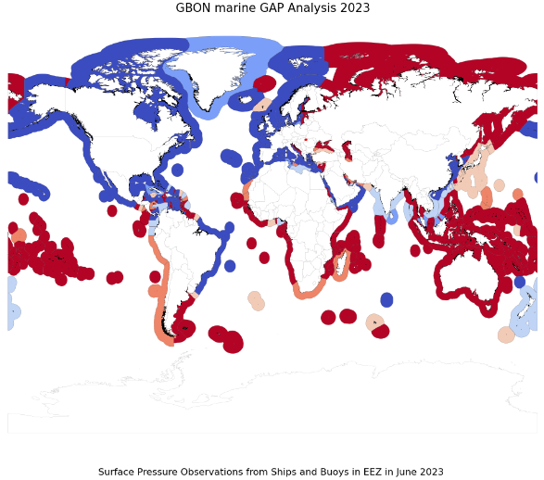
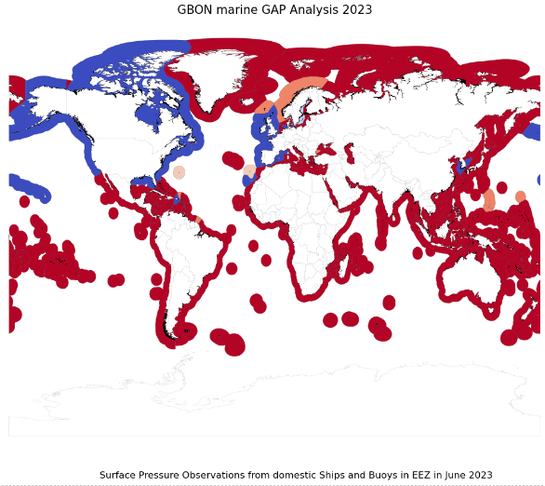
GBON Marine Gap analysis based on SLP observations in June 2023
The designations employed and the presentation of material on this map do not imply the expression of any opinion whatsoever on the part of the Secretariat of the World Meteorological Organization concerning the legal status of any country, territory, city or area or of its authorities, or concerning the delimitation of its frontiers or boundaries.
Notes:
about 53% of the observations in EEZ comes from "foreign" observations, that is, those not made by the Member, and these observations are only made in a small number of EEZ. Out of all the observations from EEZ about 54% comes from mobile platforms (i.e. drifting buoys or ships) where 27% of overall observations are from US domestic moored buoy observations, that skewing the statistics towards domestic and non-mobile.

Slide 20
WIGOS Manual (WMO-No. 1160)
3.2.2.22bis Members should operate GBON stations/platforms in areas of global commons including the High Seas and the Antarctic, according to their ability.
INFCOM-3-d08-1(1)-AMENDMENTS-WIGOS-MANUAL-ANNEX-draft1_en

Slide 21
Guide to the WMO Integrated Global Observing System (WMO-No.1165)
11.2.4 For Members whose surface area of the Exclusive Economic Zone is significantly larger than the land surface area, the GBON horizontal resolution requirement for the surface marine stations in the Exclusive Economic Zones will be applied for observations from both, surface land and surface marine observing stations/ platforms over the entirety of the area (that is, land surface area and EEZ surface area).
11.3.1 All marine stations/platforms registered in OSCAR/Surface that report observations of the variables defined in provisions 3.2.2.10 and 3.2.2.15 are considered GBON stations/platforms, due to the short life span and moving nature of many of the observing platforms.

Slide 22
Guide to the WMO Integrated Global Observing System (WMO-No.1165) contd.
11.4.2.2 A marine meteorological observing station/platform is found as GBON compliant if all three criteria (SSL 1 – SSL 3) from Table 11.2 are met for at least the measurement of sea level pressure.
Table 11.2. Compliance criteria for GBON surface land and marine meteorological observing station/platform
Mark | Name | Description | Criteria
S_{SL} 1ª | Monthly availability (%) | No. of received monthly reports^{b}/ (Days per month x 24^{c}) | ≥ 80%
S_{SL} 2 | Timeliness (%) | No. of late reports^{d}/ (Days per month x 24) | < 5%
S_{SL} 3 | Monthly quality (%) | No. of rejected monthly reports^{e}/ (Days per month x 24) | < 5%

Slide 23
Guide to the WMO Integrated Global Observing System (WMO-No.1165) contd.
M3: For surface marine meteorological GBON compliant stations (M), in Exclusive Economic Zones.
The number of Member’s surface marine GBON compliant stations (M)* in Exclusive Economic Zones, is greater than, or equal to, the required number of surface marine GBON stations (RM) from GGGA:
M ≥ R
* This number includes all contributions from all Members having stations/platforms within the EEZ of the Member in question
INFCOM-3-d08-1(2)-WIGOS-GUIDE-AND-RWC-GUIDELINES-UPDATE-ANNEX-1-draft1_en

Slide 24
Thank you.
^{wmo.int}

